Slide 1
Results ML charging behaviour

Slide 2
AC or DC: Decision tree
Largest and smallest battery sizes (little) more often DC
DC often small(er) charges
Too little data (DC) for reliable conclusions? => furher testing required

Slide 3
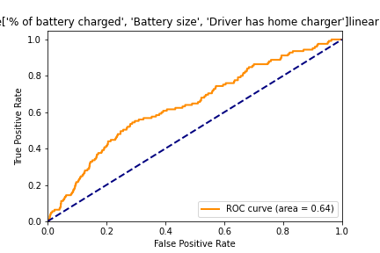
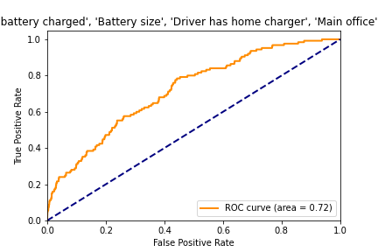
AC or DC: Regression ROC curve
% Battery charged, battery size, home charger: AUC 0.64
Main office: AUC 0.72

Slide 4
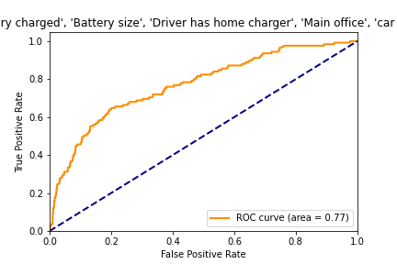
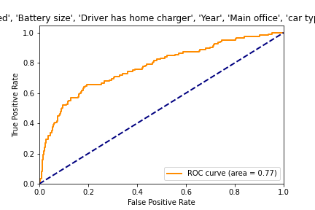
AC or DC: Regression ROC curve
Car type: AUC 0.77
Year: AUC 0.77

Slide 5
Home/office/public: Decision tree
Test Accuracy tree: 74,5% (more complex model: 86%)
(Obvious): has home charger => home most of the time
People without home charger:
More public since 2021 (less office)
Herentals public
Brussels home
People with home charger:
Since 2021 more home (less public/office)
Small battery => also in office
Main office: AUC 0.72

Slide 6
Charging cost € / kWh
See excel sheet importance parameters (linear and logistic regression)
Mean absolute deviation (MAN)= 0.03
Accuracy Without knowing public/home charge (MAN=0.047)

Slide 7
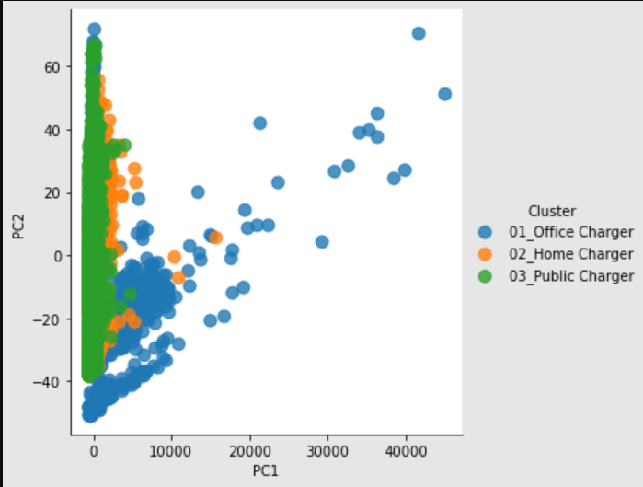
PCA
PC1: 99% duration
PC2: geladen kwH + battery size

Slide 8
Possible further research & overfit
Little data=> Possible overfit on individual users (especially for cars)
New split to check this?
Linear regression for ‘laadpaaltype’?
More data/features for more accuracy?
Binnen buiten werk uren? 7-18 kantoor
Voormiddag namiddag?
Frequentie => wanneer nodig is of wanneer kan? Elkda dag of 3 keer/week
Frederik reynaart BIM => volgende week
Cat plaasting
Excel materialendata
Model met BIM uit data conclusies trekken => doel?
Stappen ML process documenteren stappen

